Slide 1
Javascript and JQuery
SRM DSC

Slide 2
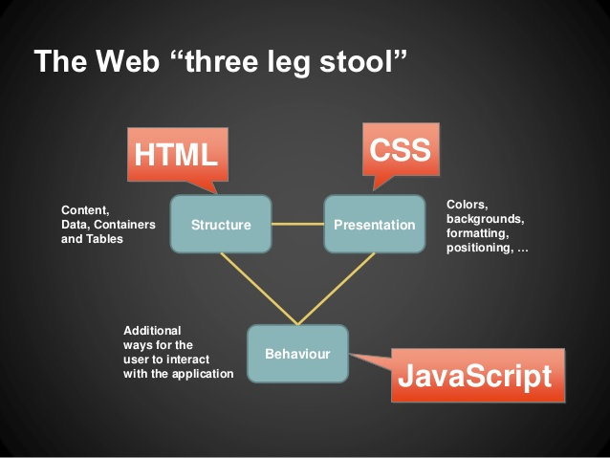

Slide 3
What happens when you do the following ?
Enter text in a text box
Click on a button
Click on links
Submit a form
All of these are events …
Some code gets executed in the background in response to a users interaction with the web page.
This code is nothing but your javascript ...
It defines what actions has to be taken in response to various interactions of the user.

Slide 4
What is Javascript ?
JavaScript is a scripting language that enables you to Create dynamically updating content Control multimedia Respond to events Animate images, and pretty much everything else. (Okay, not everything, but it is amazing what you can achieve with a few lines of JavaScript code.)

Slide 5
The <script> Tag
HTML, JavaScript code must be inserted between <script> and </script> tags.
There are two ways of adding javascript code to the HTML file using the script tags :
Directly add code between the script tags
Eg .
<html>
<head></head>
<body>
<script>
console.log(“hello world !”);
</script>
</body>
</html>
Create a javascript file with .js extension (Eg. app.js) and refer to this file in the script tag
Eg :
<html>
<head></head>
<body><script type= ”text/javascript” src= “path to your js file/app.js”></script></body>
</html>

Slide 6
Some Javascript intensive websites
https://patatap.com/
http://paperjs.org/
https://d3js.org/
http://animejs.com/
https://howlerjs.com/

Slide 7

What you will learn
JS Arrays , Objects
DOM
Handling events
A simple counter game
JQuery
To do List for Harry Potter

Slide 8
Javascript console A tool that developers use to record/ log the output of their programs To open javascript console : Open chrome developer tools (ctrl+shift+i) and go to the console tab

Slide 9
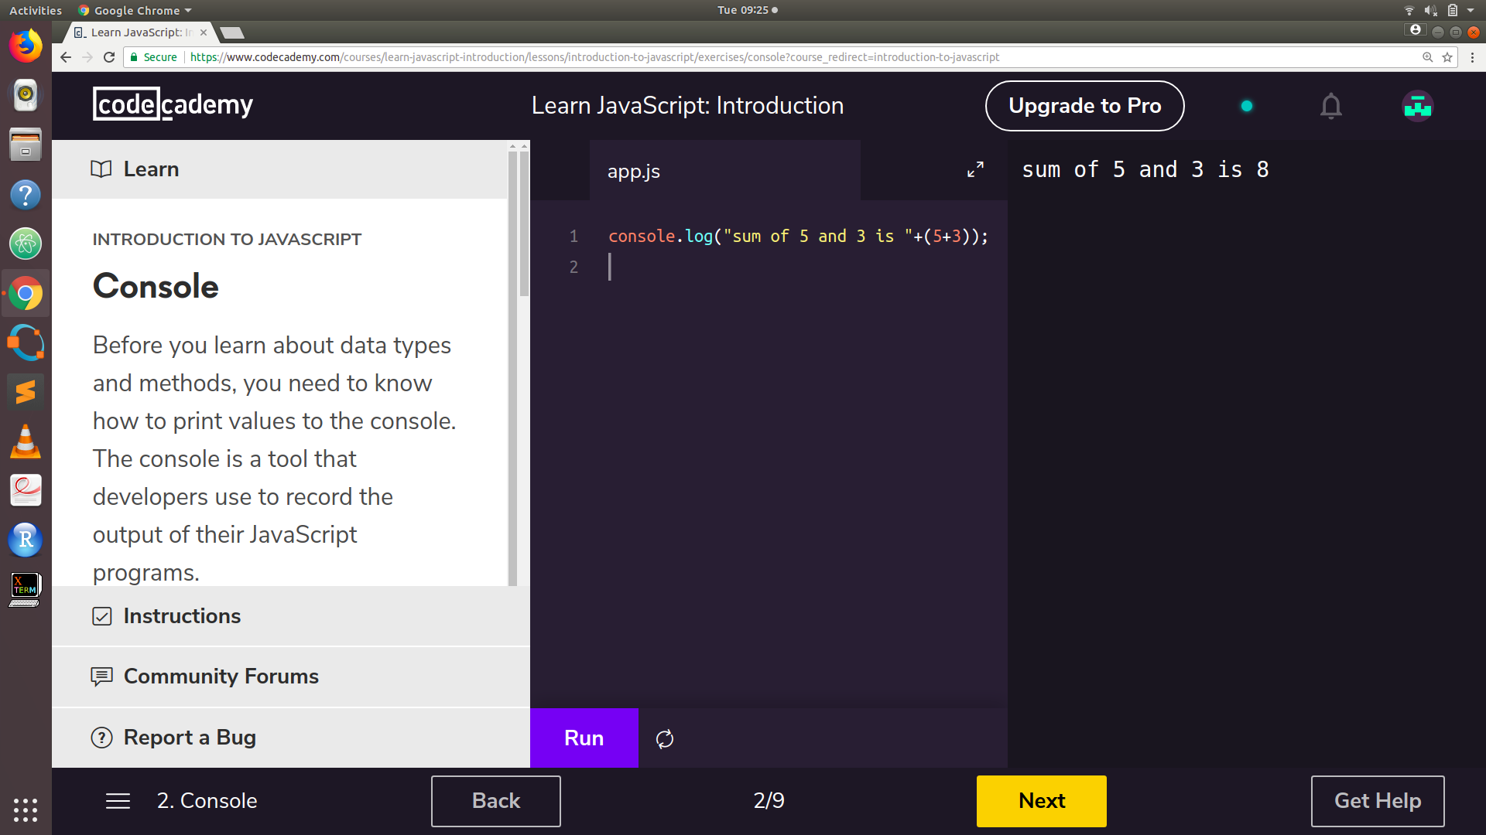
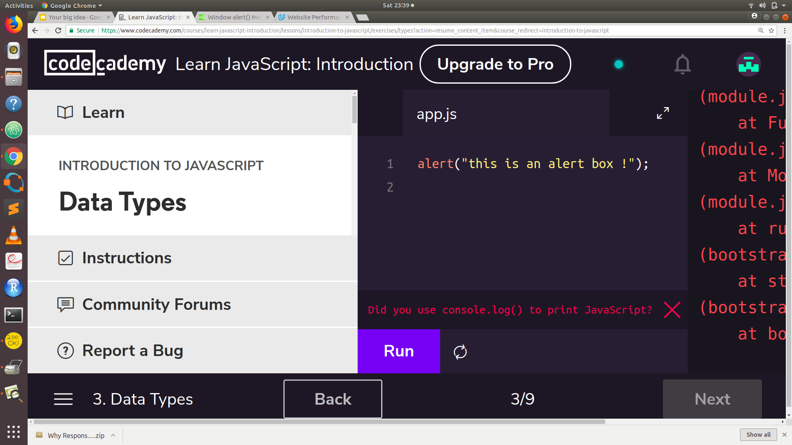
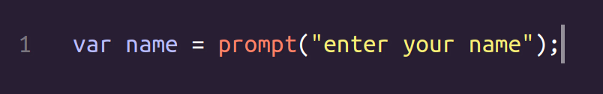
Input and output 1.console.log() - logs data in the console 2. alert () 3. prompt () - take input from user

Slide 10
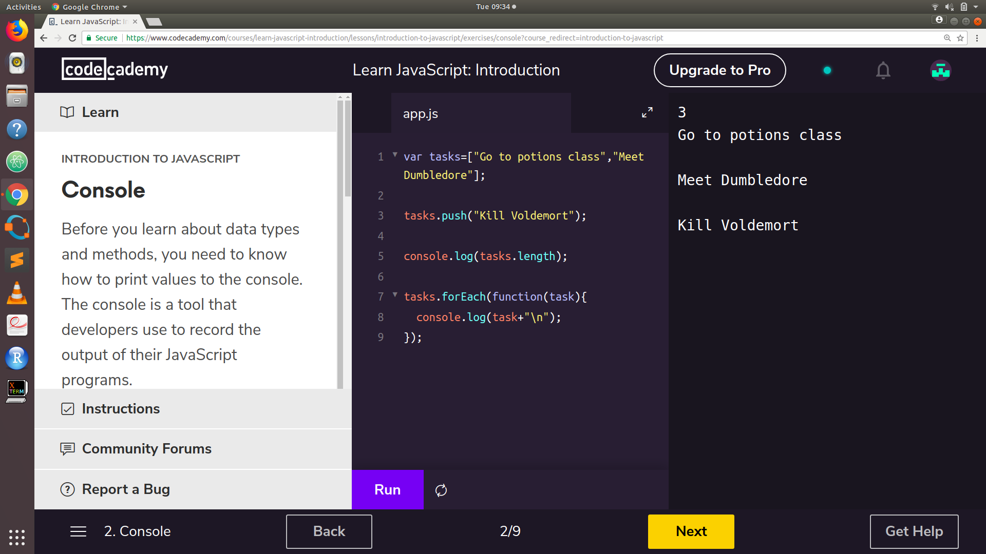
Arrays

Slide 11
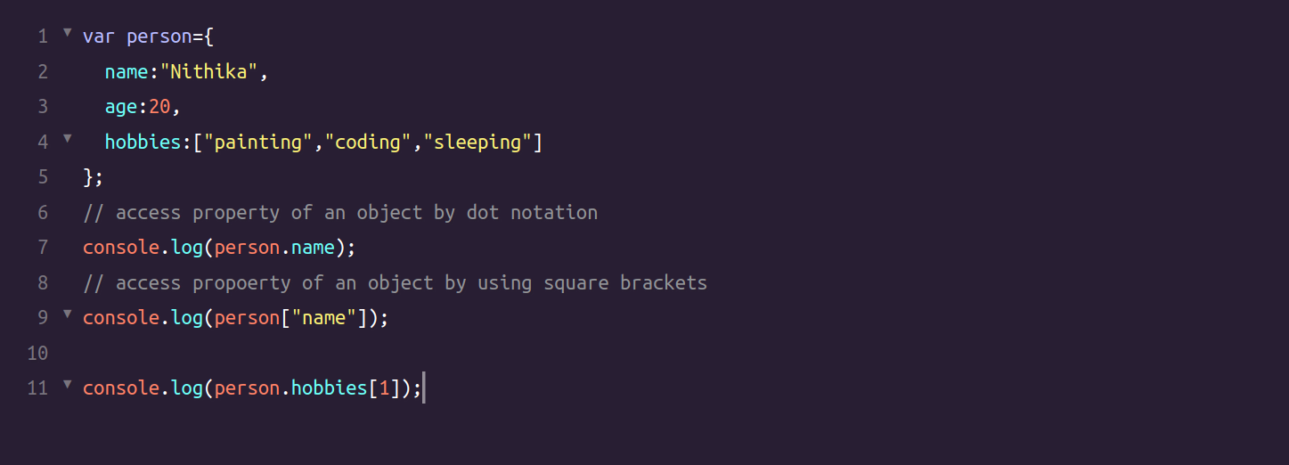
Objects Objects are collections of attributes and functions , the attributes can be of different types. Eg - here we have an object with string , number , and array of strings as its attribute type

Slide 12
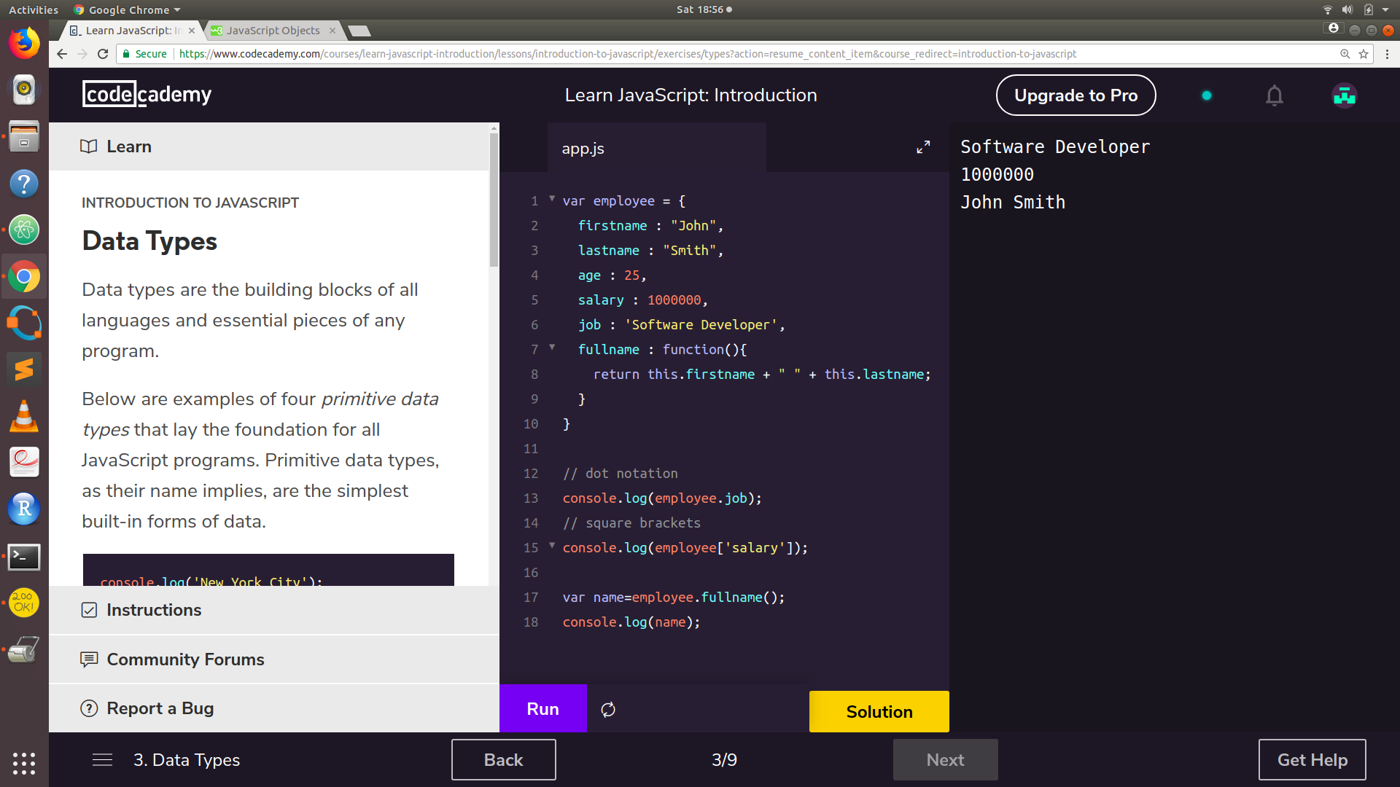

Slide 13
Document Object Model (DOM)
The HTML DOM model is constructed as a tree of Objects:
With the object model, JavaScript gets all the power it needs to create dynamic HTML:
JavaScript can change all the HTML elements in the page
JavaScript can change all the HTML attributes in the page
JavaScript can change all the CSS styles in the page
JavaScript can remove existing HTML elements and attributes
JavaScript can add new HTML elements and attributes
JavaScript can react to all existing HTML events in the page
JavaScript can create new HTML events in the page

Slide 14
DOM TREE EXMAPLE Consider the following html code <!DOCTYPE html> <html> <head> <title>Page Title</title> <meta http-equiv="content-type" content="text/html; charset=utf-8" /> <meta http-equiv="Content-Language" content="en-us" /> </head> <body> <h1>This is a heading</h1> <p>A paragraph with a <a href="http://www.google.com/">link</a>.</p> <ul> <li>a list item</li> <li>another list item</li> <li>a third list item</li> </ul> </body> </html>

Slide 15
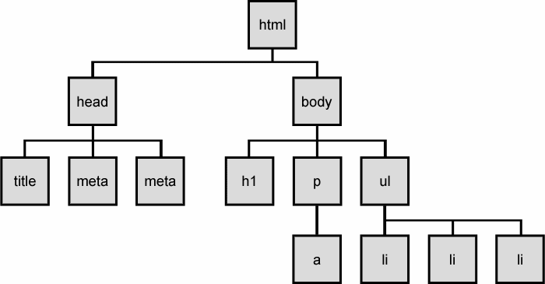
DOM Tree - every node of the tree is a HTML element

Slide 16
Finding HTML Elements 1. document.getElementById ( id ) - Find an element by element id 2. document.getElementsByTagName ( tag name ) - Find elements by tag name 3. document.getElementsByClassName ( class name ) - Find elements by class name 4. document.querySelector ( css selector ) - find first of the set of elements found by valid css selectors 5. document.querySelectorAll ( css selector ) - find the set of all elements found by valid css selectors

Slide 17
Adding and Deleting Elements document.createElement (element) - Create an HTML element document.removeChild (element) - Remove an HTML element document.appendChild (element) - Add an HTML element document.replaceChild (element) - Replace an HTML element

Slide 18
Changing HTML Style To change the style of an HTML element, use this syntax: document.getElementById(id).style.property = new style Eg : document.getElementById(‘btn1’).style.color=’red’; Changing Attribute of HTML element To change the attribute of an HTML element, use this syntax: document.getElementById(id).attribute = new value Eg : document.getElementById(‘Myimage’).src=’hagrid.jpg’;

Slide 19
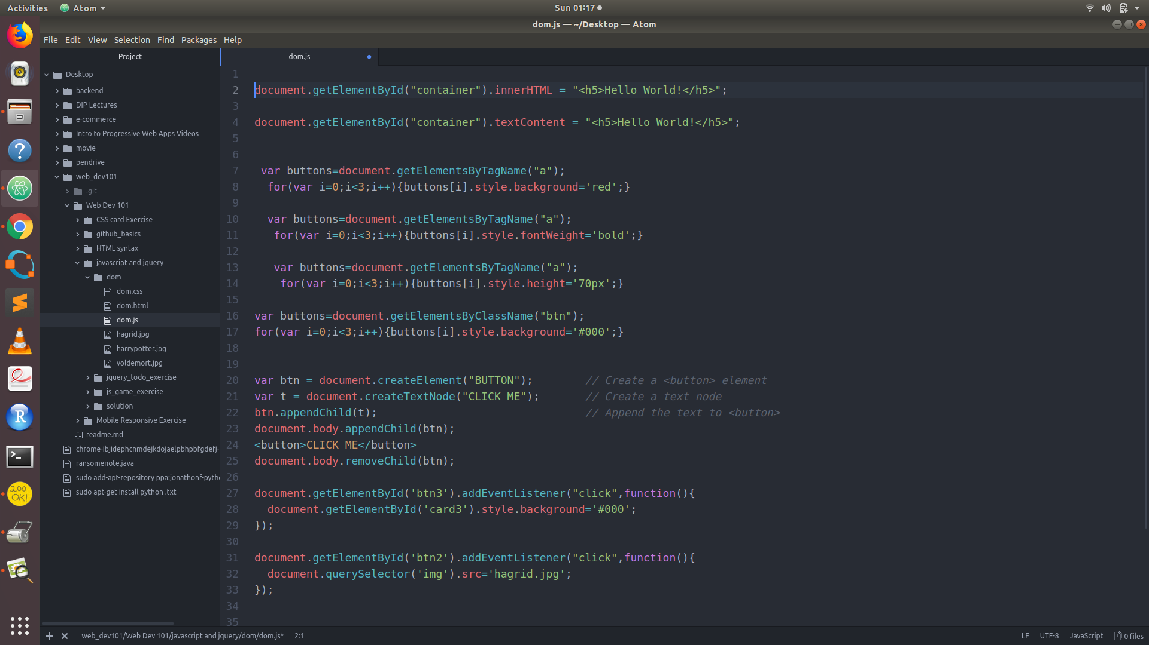

Slide 20
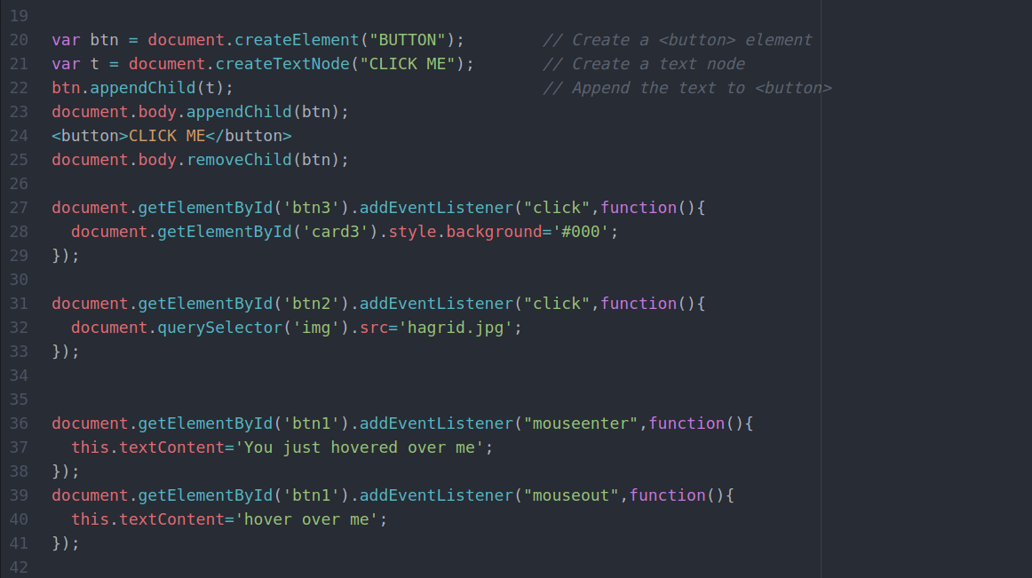

Slide 21
DOM Events
A JavaScript can be executed when an event occurs, like when a user clicks on an HTML element.
Examples of HTML events:
When a user clicks the mouse
When a web page has loaded
When an image has been loaded
When the mouse moves over an element
When an input field is changed
When an HTML form is submitted
When a user strokes a key

Slide 22
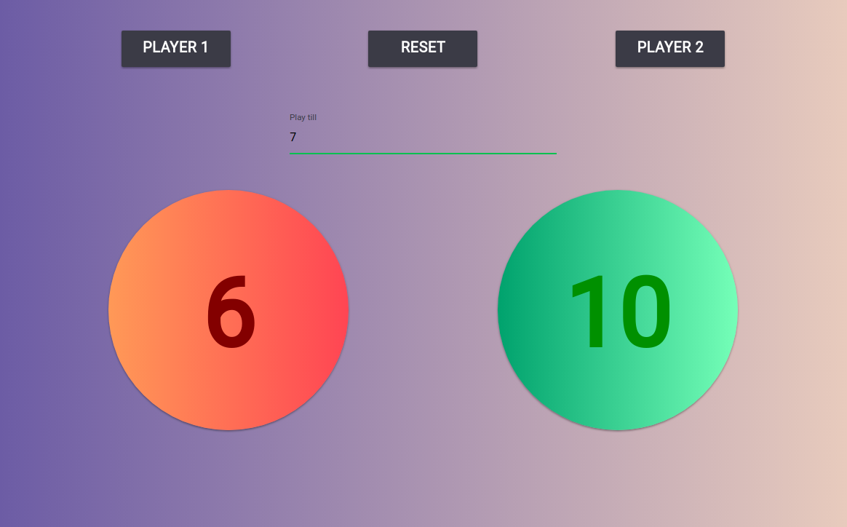
Player count game

Slide 23
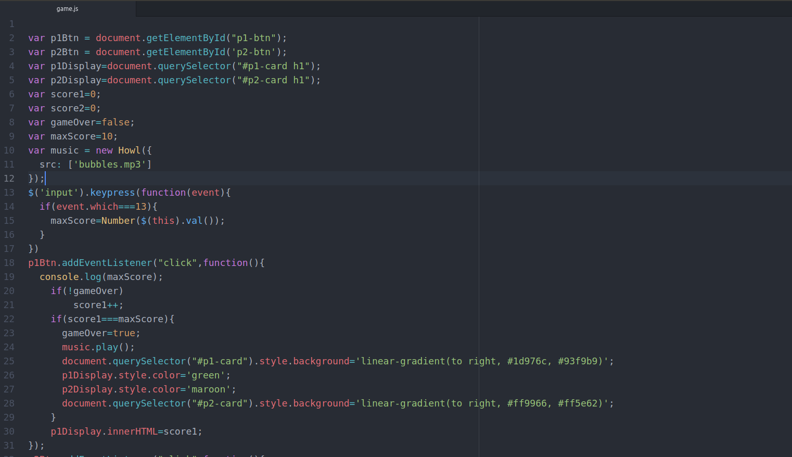

Slide 24
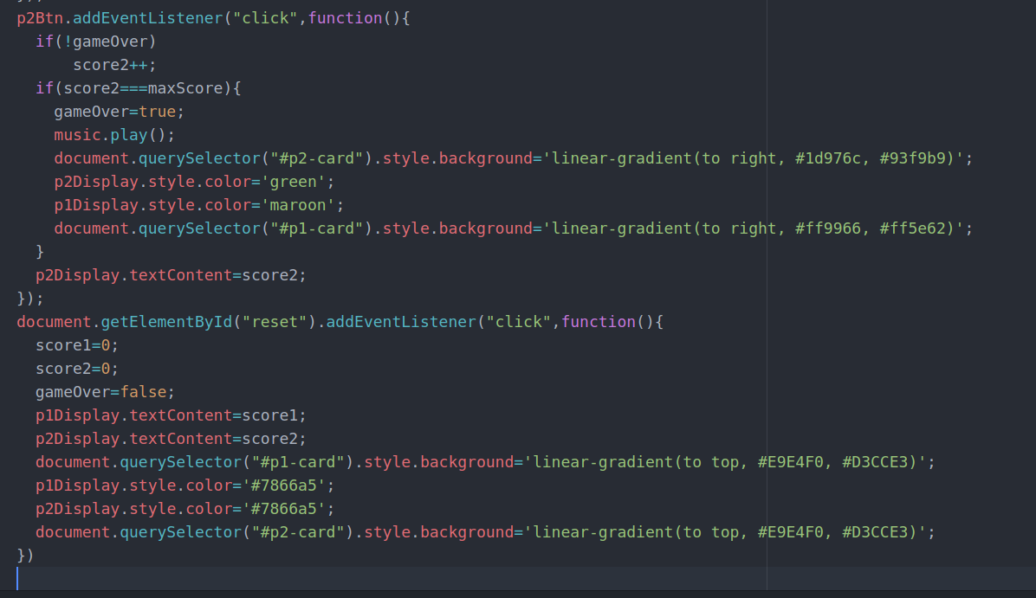

Slide 25
What is JQuery and why use JQuery ?
jQuery is a fast, small, and feature-rich JavaScript library.
It makes things like HTML document traversal and manipulation, event handling, animation, and Ajax much simpler with an easy-to-use API that works across a multitude of browsers.
With a combination of versatility and extensibility, jQuery has changed the way that millions of people write JavaScript.

Slide 26
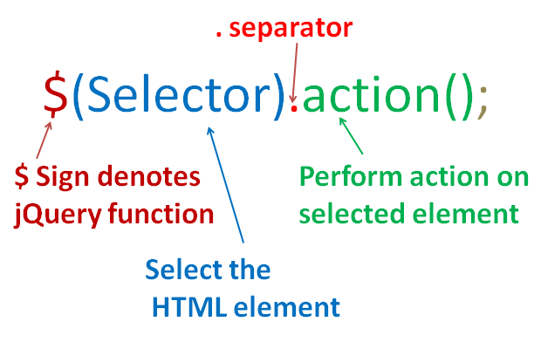
JQuery Syntax

Slide 27
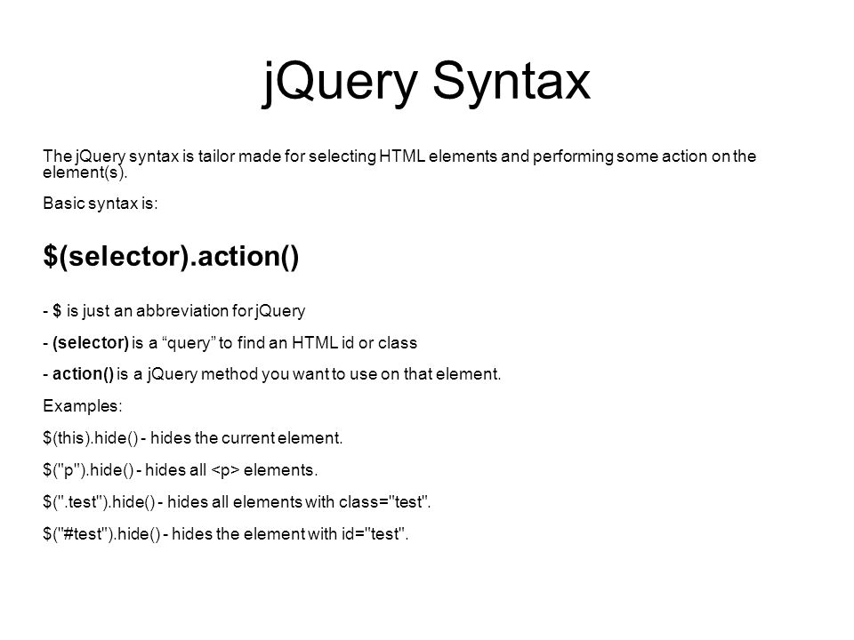

Slide 28
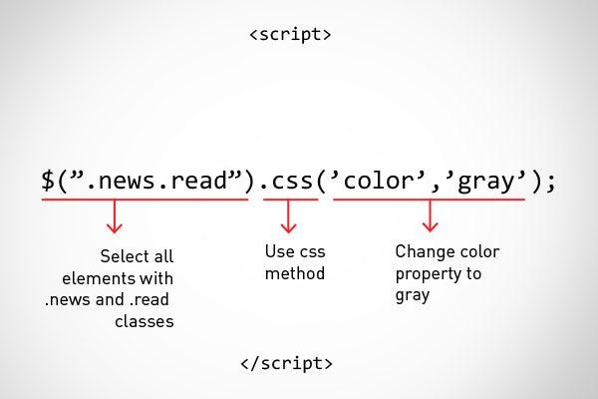
Change css of element using Jquery

Slide 29
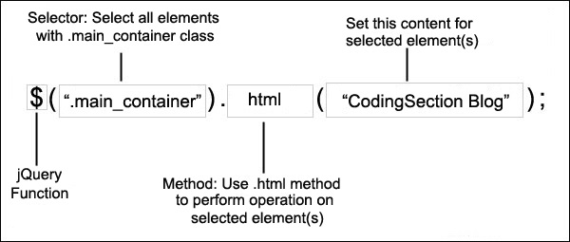
JQuery syntax to change the HTML of element

Slide 30
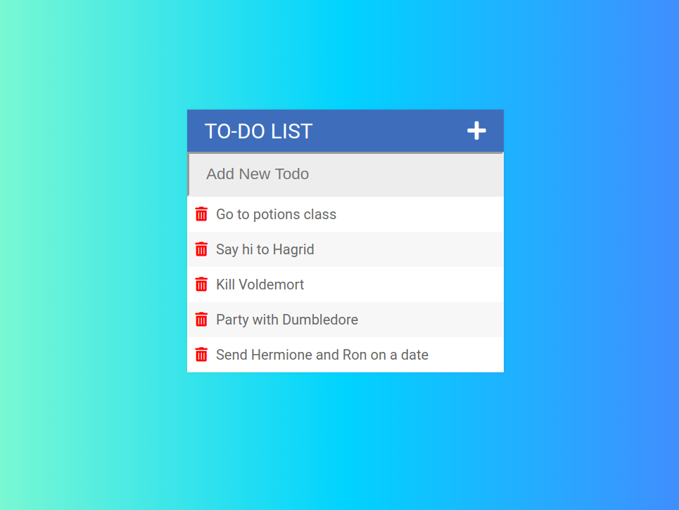
To do List for Harry Potter

Slide 31
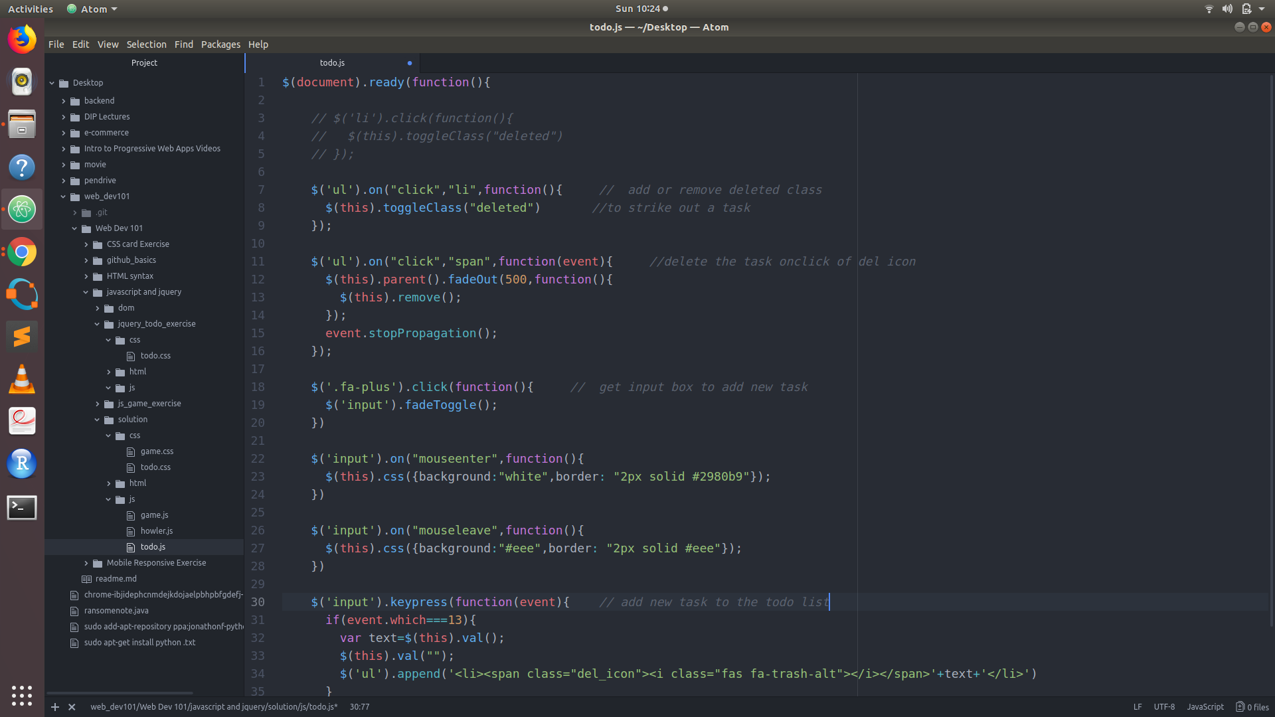

Slide 32
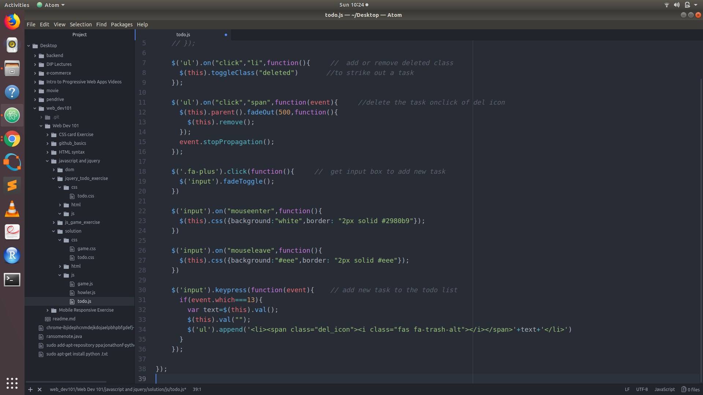

Slide 33
Resources to learn Javascript and JQuery
https://www.javascript.com/
https://www.w3schools.com/js/
https://www.w3schools.com/jquery/jquery_intro.asp
https://learn.jquery.com/

